Slide 1
ELD Activities and Support
Extended Listening Comprehension Practice

Slide 2
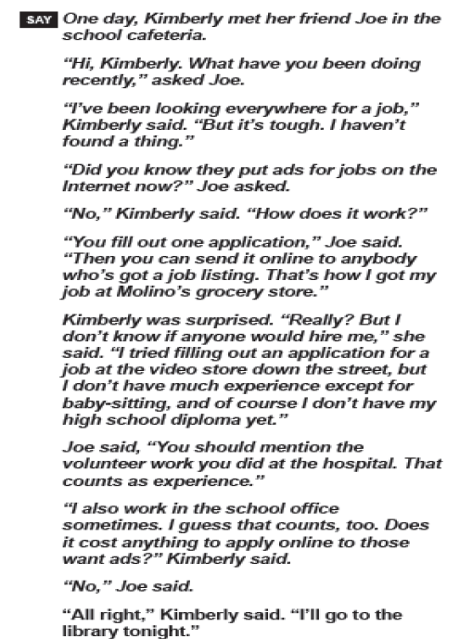
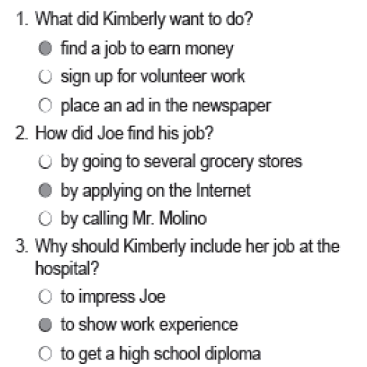
Read the passage to the students. Then read the questions and answer choices to them as they answer the questions.

Slide 3
Extended Listening Comprehension
It was lunchtime and Kim was running as fast as she could to Ms. Chin’s Classroom. She wanted to play with Buster. Who’s Buster, you ask? Buster is a fluffy black and white rabbit that Ms. Chin keeps in her classroom. Ms. Chin teaches science, and she brought Buster to school for her students to study. If students want to play with Buster or hold him or feed him, they have to come to Ms. Chin’s classroom during lunchtime. So Kim was on her way to see Buster. She had never fed a rabbit before, and she wanted to see Buster before the other children did.

Slide 4
Extended Listening Comprehension Questions
19. Where was Kim going?
a. She is going to a classroom
b. She is going to the pet store
c. She is going to the lunchroom
d. She is hungry
20. Who is Buster?
a. He is a friend of Kim’s
b. He is Kim’s pet rabbit
c. He is Ms. Chin’s rabbit
d. He is a person
21. What did Kim want to do?
a. Kim wanted to eat lunch
b. Kim wanted to feed Buster
c. Kim wanted to play outside
d. Kim wanted to have breakfast
22. Why did Ms. Chin bring buster?
a. to make it talk
b. for her students to study it
c. to play
d. to be free
23. When can the students feed and hold buster?
a. after school
b. inside the classroom
c. at home
d. during lunch

Slide 5
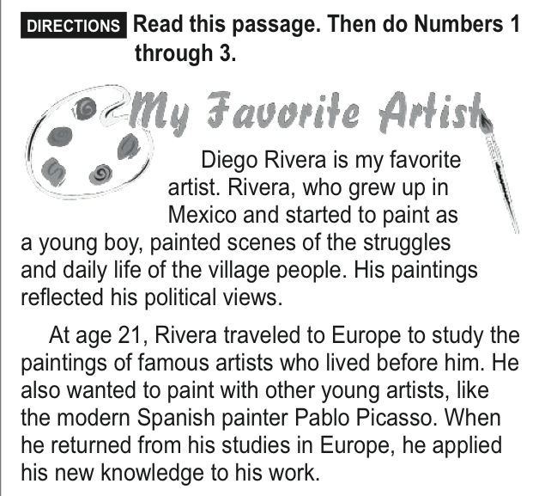
Notes:
*The students are reading this passage on their own this time.

Slide 6
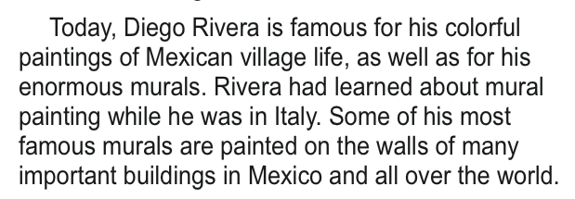
The passage continues……..
Notes:
*The students are reading this passage on their own this time.

Slide 7
